Slide 1

The Universal Encouragement Program
An online guidance assessment, reporting, communications, and evaluation system for schools and education support programs.

Slide 2
The Universal Encouragement Program
Developed and distributed by Encouragement Services, Inc. (ESI)
Bloomington, Indiana
Scott Gillie
Executive Director

Slide 3
If you accidentally leave the webinar or lose the connection…
You may log in again using the hyperlink that you used to enter the first time.
If you have problems reconnecting,
Call GoToWebinar: 800 263-6317
Text Scott: 812 360-4744

Slide 4
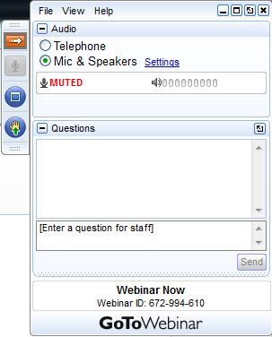
Introduction to the Universal Encouragement Program
Using the control panel
Clicking on the arrow in the orange box closes your control panel (click again to re-open)
All attendees are muted during the presentation. Click on the raise hand icon to ask to be un-muted. (Click on the microphone icon to re-mute yourself.)
We want you to interact!
Text your question or comment to the presenter.
Please ask your question or make your comment any time during the webinar

Slide 5
Introduction to the Universal Encouragement Program
Online assessment system for supporting student achievement and attainment
Data for better understanding student needs, interests, and experiences
Data to make a difference in students’ lives

Slide 6
Introduction to the Universal Encouragement Program
Slideshow online: www.capenetwork.org/uep.pdf
Access to slides, documents, and hyperlinks
Sample reports, presentations, documentation, and assessment previews: www.capenetwork.org/docs.htm

Slide 7
Today’s Agenda
Why we are doing this…
Introduction to the Universal Encouragement Program
Individual Student Report
Student Factor Summary Report
Student Involvement Preferences Report Grade 9
School Engagement Concerns Report Grade 9
College Readiness Concerns Change Report
Key Benchmarks Change Report
Notes:
It is helpful to print these documents in advance of the session.

Slide 8
How can we intelligently guide young people toward college and careers in the current environment?
Fewer counselors for more students
Diminished resources for supportive services
Increasing proportions of minority, immigrant, and low-income students in our schools
Academic accountability pressures that limit group access

Slide 9
How can we intelligently guide young people toward college and careers in the current environment?
Gather data specifically for guidance, counseling, and student support
Analyze and share that data
Use data to place guidance resources where most needed
Use data to effect change
  Advocacy
  Service alignment with identified needs and interests
  Intensive services for those with most urgent needs

Slide 10
How can we intelligently guide young people toward college and careers in the current environment?
Work one-to-many
Work collaboratively
Study the results of our work

Slide 11
The Universal Encouragement Program
UEP – What does it do?
Gathers hundreds of guidance data elements
Summarizes, reports, and compares data
Identifies where guidance resources are most needed
Documents change and changes needed
Enables one-to-many with guidance messaging and group membership identification

Slide 12
The Universal Encouragement Program
UEP – What is assessed?
Factors that affect motivation, engagement, achievement, persistence, graduation, and postsecondary participation and success

Slide 13
What is action research?
Rooted in our work to assist students
Less formal in methodology (but informed by research)
Developed collaboratively and shared with stakeholders to engage them
Guides programming efforts (put into practice)
Leads to problem-solving and action-planning

Slide 14
What is action research?
Action research is a reflective process of progressive problem solving led by individuals working with others in teams or as part of a "community of practice" to improve the way they address issues and solve problems.
Kurt Lewin
Notes:
Guidance assessment informs our efforts to support all students in achieving their education and career goals. Further, guidance assessment data enable counselors, administrators, teachers, parents/guardians, mentors, and other members of the student-support system to engage with guidance issues specifically and concretely and to measure the effects of their support over time.

Slide 15
The UEP is action research.
Action research is a reflective process of progressive problem solving led by individuals working with others in teams or as part of a "community of practice" to improve the way they address issues and solve problems.
Kurt Lewin
Notes:
Guidance assessment informs our efforts to support all students in achieving their education and career goals. Further, guidance assessment data enable counselors, administrators, teachers, parents/guardians, mentors, and other members of the student-support system to engage with guidance issues specifically and concretely and to measure the effects of their support over time.

Slide 16
The UEP is action research.
Plan your data collection
Collect your data
Share your data and work together in interpretation
Formulate action strategies to address issues of greatest concern

Slide 17
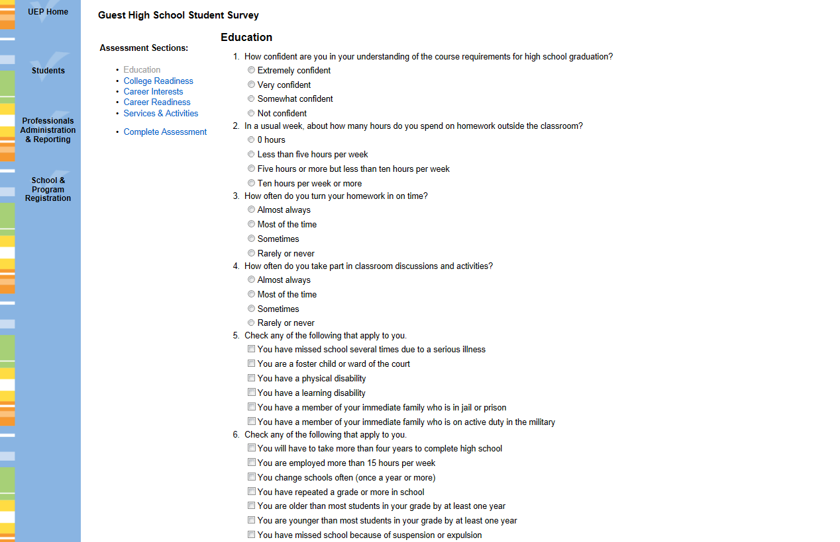
Online assessment takes 15-30 minutes

Slide 18
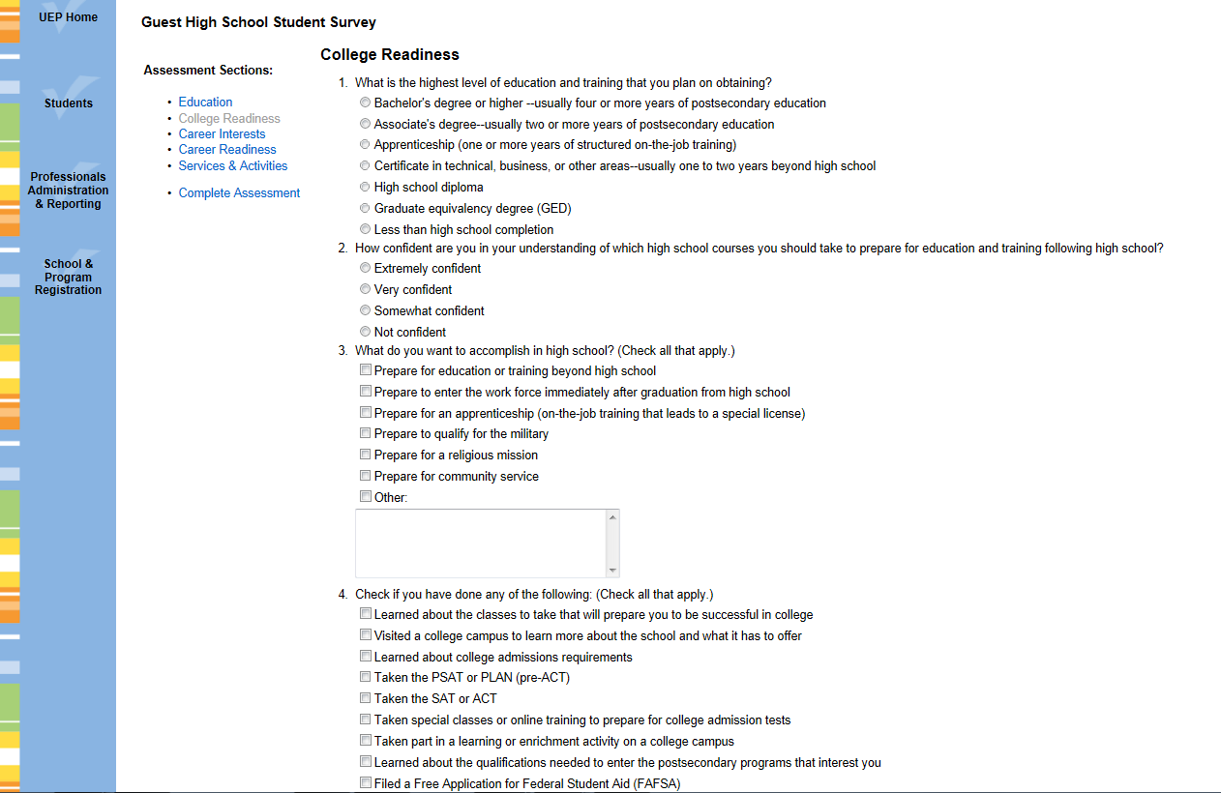
Students point and click in their native habitat

Slide 19
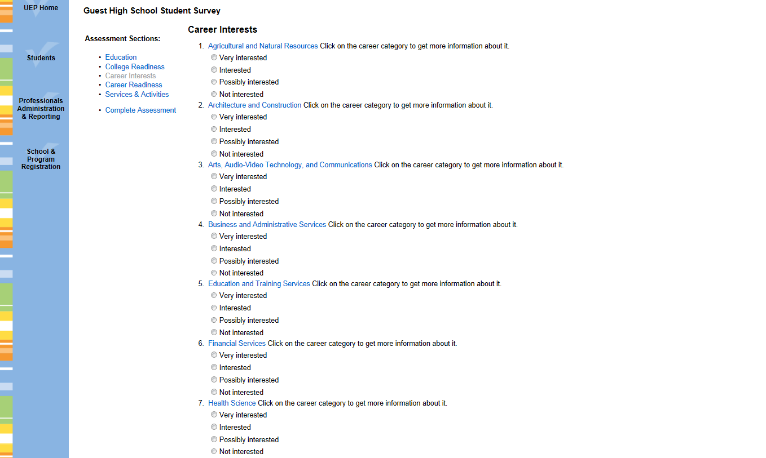
Results are available instantly

Slide 20
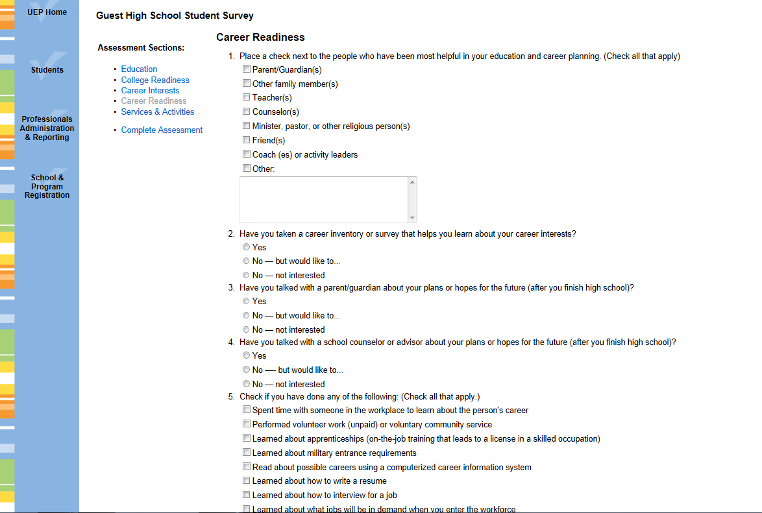
Easily share summaries with teachers, parents, & administrators

Slide 21
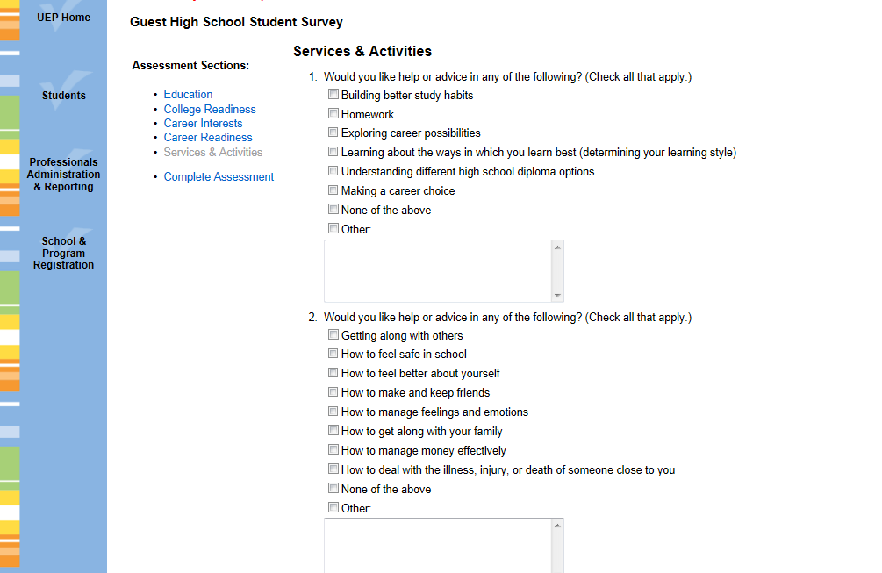
See what students want

Slide 22
Available at no cost to schools and education support programs
Web-based student survey system
Register online at www.capenetwork.org
Automated registration provides unique hyperlinks
Targeted to grades 6-12 and beyond

Slide 23
Available at cost to states, districts, and groups of schools or programs
Group-wide reporting
Group-wide communications
Within-group comparisons
Customized and standardized assessments

Slide 24
Three Standard Forms
Form 1 – Grades 6-8
Form 2 – Grades 9-12
Form 3 – Beyond high school

Slide 25

Three Standard Forms

Slide 26
Customized Form
One form for all grades*
Form items will be different for different grades
Form name is Your School/District/State Guidance Questionnaire
Each school/program will have a unique link for students to use to take the assessment (keeps data separate)
* Select which items are displayed for each grade level.

Slide 27
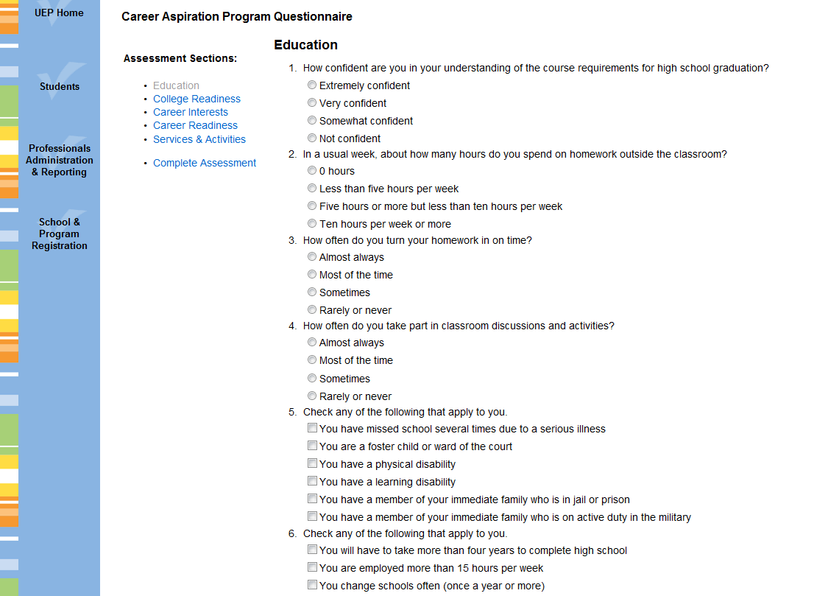
Missouri Connections Student Questionnaire

Slide 28
Customize the Standard Forms
Change form name and item group titles
Add, delete, or change item groups and items
Assign items to specific grade or grades
Reorder items or assign to different group
and
Create custom surveys for any audience

Slide 29
Customize Your Use
Create registration groups (career pathways, counselors, advisors, etc.)
Manage users and authorize system privileges
Create date ranges for reporting
Create reporting groups (selected students from a list)
Create and save custom reports

Slide 30
Sample Custom Report
Subjects for which students seek assistance
Subject | Percent Seeking Assistance
Mathematics | 42.72
Science | 28.46
English/Language Arts | 21.34
Foreign Language | 19.48
Computing | 9.92
Reading | 7.33

Slide 31
Data from Three Domains
Academics, engagement, and involvement
College and career readiness
Career interests
Career development
Future planning
Interests in guidance and support services
Plans and aspirations

Slide 32
Data from Three Domains and
Important Background Characteristics
Household level of education – first gen status
Living situation
Usual grades earned
Language spoken in the home

Slide 33
Standard and Custom Reporting
Individual and group summaries
Key factor summaries
Comparison reports
Change reports
Custom reporting on any item response or group of item responses

Slide 34
School Engagement Concerns Report
Students whose engagement and effort place them at high risk for poor achievement and dropping out
School Engagement Concerns Report
Report lists students in order of greater to fewer risk factors
Report lists factors in order of greater to fewer students associated

Slide 35
High School Engagement Concerns Report
172 of 448 respondents in 2012-13 grade 9 associated with 4 or more factors
Send email to listed respondents and/or parents/guardians
1. |  | Student Name | 14/32
2. |  | Student Name | 14/32
3. |  | Student Name | 13/32
4. |  | Student Name | 12/32
5. |  | Student Name | 12/32
6. |  | Student Name | 12/32
7. |  | Student Name | 11/32
8. |  | Student Name | 11/32
9. |  | Student Name | 11/32
10. |  | Student Name | 11/32

Slide 36
Female, grade 9, age 15, white/non-Hispanic, earns mostly Bs and Cs, lives with mother and stepfather
Assessed 9/19/2011
What do we have to build upon in this list?
School Engagement Concerns Low level of education in household Repeated one or more grades Learning Disability Suspension or expulsion Multiple absences due to serious illness No helpful people for education and career planning Must take more than four years to graduate from high school High cost of education and training Not involved in extracurricular activities Zero homework hours per week No career interests Classes aren't challenging Classes aren't interesting Less than full effort applied to classes

Slide 37
Female, grade 9, age 15, white/non-Hispanic, earns mostly Bs and Cs, lives with mother and stepfather
Assessed 9/19/2011
How about this list?
Student Involvement Preferences Would like more information on paying for college Would like more information about how and when to apply for scholarships Would use tutoring (if it were available) Would like to formulate career plan for high school and beyond Would like help or advice in learning about the different options for education and training beyond high school Would like help or advice with an issue that could prevent taking part in education and training Would like help or advice with which college admission test to take Would like help or advice in getting ready for college admission tests Would like help or advice in how to earn college credit while in high school Would like to take part in college visit

Slide 38
Female, grade 9, age 15, white/non-Hispanic, earns mostly Bs and Cs, lives with mother and stepfather
Assessed 9/19/2011
Does anybody know?
Student Involvement Preferences Would like more information on paying for college Would like more information about how and when to apply for scholarships Would use tutoring (if it were available) Would like to formulate career plan for high school and beyond Would like help or advice in learning about the different options for education and training beyond high school Would like help or advice with an issue that could prevent taking part in education and training Would like help or advice with which college admission test to take Would like help or advice in getting ready for college admission tests Would like help or advice in how to earn college credit while in high school Would like to take part in college visit

Slide 39
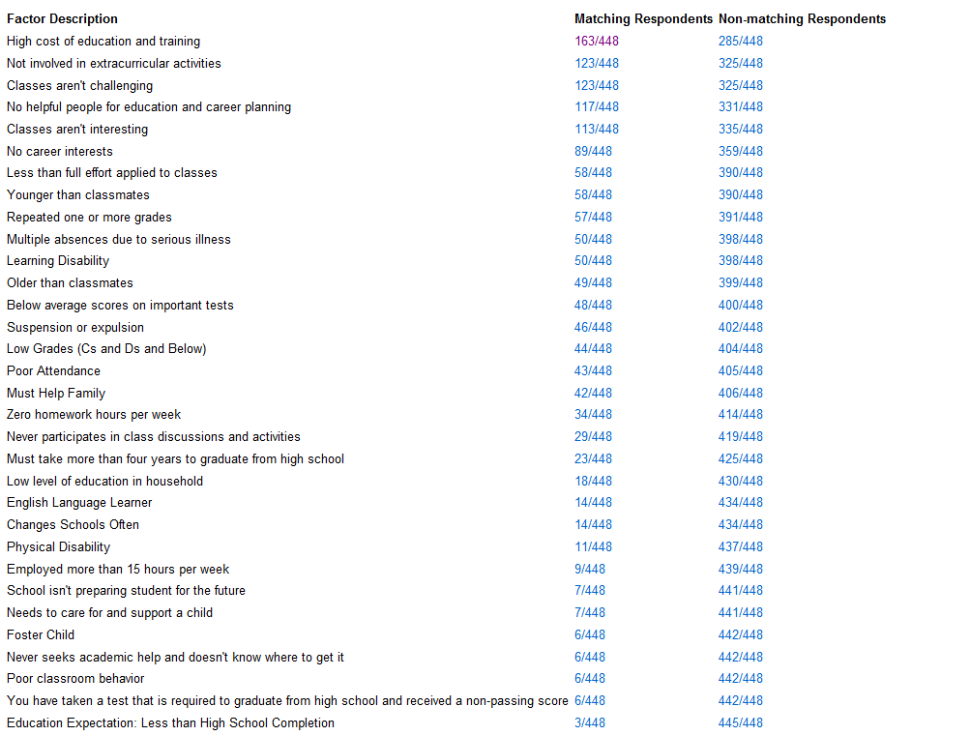
Grade 9 School Engagement Concerns, 2012-13

Slide 40
Top Ten Student Involvement Preferences Grade 9, 2011-12
 | Factor Description | Respondents
1 | Would use tutoring (if it were available) | 403/471
2 | Would like to take part in college visit | 325/471
3 | Would like more information about how and when to apply for scholarships | 287/471
4 | Would like to take part in learning experience on a college campus | 222/471
5 | Would like help or advice in how to earn college credit while in high school | 207/471
6 | Would like to talk with counselor about plans or hopes for the future | 206/471
7 | Would like more information on paying for college | 202/471
8 | Would like to formulate career plan for high school and beyond | 199/471
9 | Would like to visit a worksite in a field of work that interests you | 187/471
10 | Would like help or advice in learning about the different options for education and training beyond high school | 187/471

Slide 41
Filtering Reports
Show subgroup results
Compare subgroup with larger group
Compare subgroup with another subgroup
Many filtering options

Slide 42
UEP Messaging
For popular information requests
Send email to selected or target groups of students
Send email to parents/guardians
Send student reports to colleagues

Slide 43
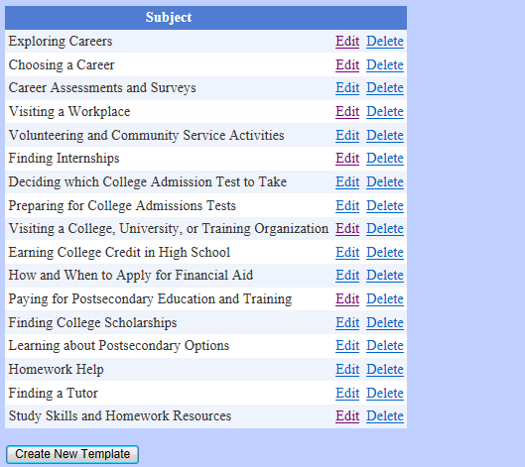
Counselor Template Communications

Slide 44
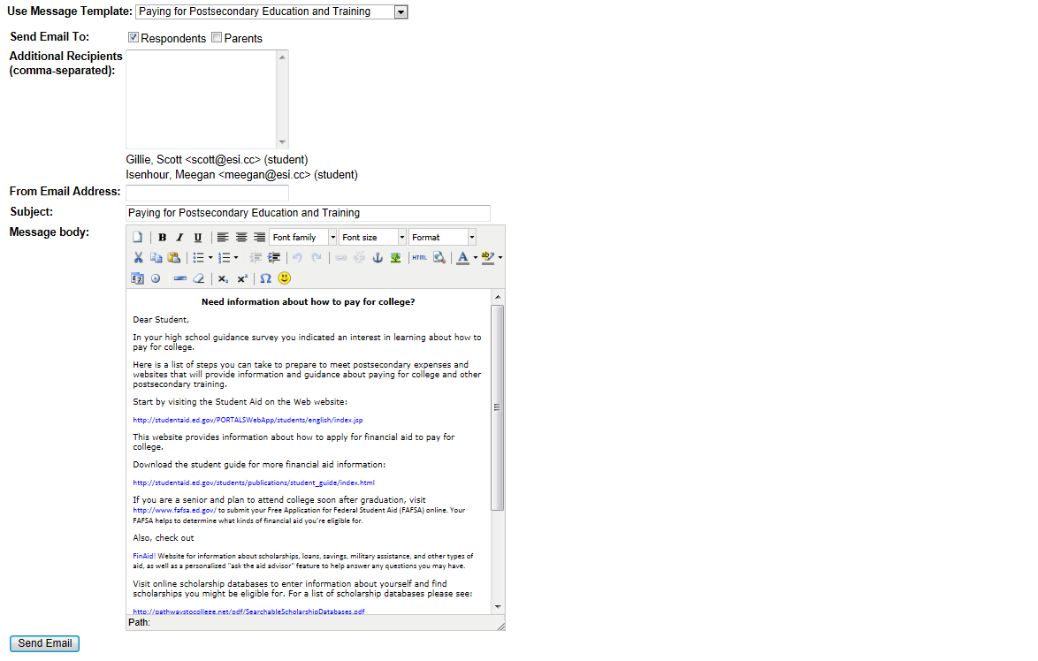

Slide 45
The WHYS of guidance assessment
Simply put…
We want more students to graduate from high school prepared for postsecondary education, and equipped to be successful in postsecondary education. In the U.S., the student-to-counselor ratio is 459:1.
Source: U.S. Department of Education, Common Core of Data, National Institute for Educational Statistics-Public Elementary and Secondary School Student Enrollment and Staff From the Common Core of Data: School Year 2009-2010. Retrieved from www.schoolcounselor.org (American School Counselor Association).
The association recommends a student-counselor ratio of 250:1.
Notes:
Ratios are part of the issue. Job descriptions that reserve counselors’ time to focus on students’ academic, career, and personal-social guidance needs are essential as well.

Slide 46
U.S. High School Graduation, College Continuation, and Chance for College 1986-2010
Source: Tom Mortenson and Nicole Brunt. Postsecondary Education OPPORTUNITY, 2013.
Notes:
The top line indicates the U.S. High School graduation rate between 1986 and 2008. The middle line indicates the college continuation rate for this period. The college continuation rate is the percentage of high school graduates that pursue postsecondary education (two-year or four-year) immediately following high school. The bottom line is the chance for college by age 19. This indicates the percentage of beginning ninth graders who enter college four years later.
These figures are supplied by Tom Mortenson and Nicole Brunt. Tom is the publisher of Postsecondary Education OPPORTUNITY, an important journal for anyone interested in data that inform higher education policy in the U.S.

Slide 47
Guidance assessment to improve student outcomes
Many of the data points associated with high school completion and postsecondary participation are evident
“…most future dropouts can be predicted as early as 6th grade by studying academic and engagement issues among these students in elementary and middle schools.”
(Balfanz, Herzog, & Mac Iver. 2005)
Notes:
“Many students in urban schools become disengaged at the start of the middle grades, which greatly reduces the odds that they will eventually
graduate…. four predictive indicators reflecting poor attendance, misbehavior, and course failures in sixth grade can be used to identify 60% of the students who will not graduate from high school.”

Slide 48
Guidance assessment to improve student outcomes
Many of the data points associated with high school completion and postsecondary participation are evident
EARLY
Notes:
“Many students in urban schools become disengaged at the start of the middle grades, which greatly reduces the odds that they will eventually
graduate…. four predictive indicators reflecting poor attendance, misbehavior, and course failures in sixth grade can be used to identify 60% of the students who will not graduate from high school.”

Slide 49
Top 3 School Engagement Concerns – Missouri Middle School Grades 6-8

Slide 50
Want to experience the assessment system?
Take an assessment to see what it’s like
Go to www.capenetwork.org/ Click on the Students Menu and select the assessment you would like to take
Enter guest as the authorization code on the student information page
Complete the sections of the information page with *
Take the assessment – aliases welcome

Slide 51
Want to experience the assessment system?
Use admin tools and reports
Go to www.capenetwork.org/forprofessionals.aspx
Select Administration and Reporting Tools
Enter guest as the email address
Enter guest1 as the password
Use the links to view the tools and generate reports
Note: data from the ‘Guest School’ derive from counselors, graduate students, and other trainees who have participated in hands-on training sessions. If you take an assessment, your data will be visible to others. Feel free to use an alias and fictitious data. Go to Show All Respondents in Administration and Reporting Tools to view your individual reports.

Slide 52
Assessment Implementation
Read Instructions for Assessment Administrators
Let students know a few days before that they will need to know
  Student email address (if the student has one)
  Parent email address
  Highest level of education completed by parent or guardian

Slide 53
Assessment Implementation
Let students know that you are collecting information that will help the program to better serve students
Let students know that their responses will inform your ability to provide assistance
Let students know that you want them to give serious consideration to all of the questionnaire items (and that there aren’t right or wrong answers)

Slide 54
Assessment Implementation
Direct students to the hyperlink that takes them to the questionnaire – either on the computer desktop or as a link on the school website
Let students know that most students complete the assessment in about 20 minutes and that more time will be allowed if students need more time. It is important that students not feel rushed to complete.

Slide 55
Getting Your Reports
Each UEP site administrator has access to their students’ data (and can provide access to others)
Log in to the reporting tools at www.capenetwork.org – Under the Professionals menu, the first bulleted item is Administration and Reporting Tools

Slide 56
Registration
Go to registration link at www.capenetwork.org
Select school or program registration
School? Enter zip code in upper registration code
Find your school? Click select and auto register
Not there? Use manual option and wait for approval
Program? Enter data in form and wait for approval

Slide 57
Questions or more information
Information brief about the UEP state (group) guidance data system
One-page description of the UEP for schools and programs
Sample reports, assessment previews, and more
Join our online guidance assessment community
Contact
    Scott Gillie
    Executive Director
    Encouragement Services, Inc.
    5931 West State Road 46
    Bloomington, Indiana 47404
    812.876.5055 or 812.360.4744
    scott@esi.cc

Slide 58
The Universal Encouragement Program
An online guidance assessment, reporting, communications, and evaluation system for schools and education support programs.
Presentation online at www.capenetwork.org/uep.pdf

